Slide 1

Heart Stroke Prediction:
By Group 12:
Abbasi, Seyed Amir Kiarash
Alan, Baris
Ardalanasl, Mohammad
Khimani, Renish Samir
Li, Chue San Gavin
Maran Vieira Da Silva, Taiguara
Mehmood, Hassan
Monzato Grigorio, Gabriel
Thomas, Shane

Slide 2


Predicting Heart Stroke:
How are we going to predict?
The Data
Gathered data from Kaggle .
Identified the risk factors associated with Heart Stroke.
Finding the probability of the risk of Heart Stroke based on historical data.
Defining it as a classification problem.
Residence Type
Average Glucose Level
BMI*
Smoking Status
Stroke
ID
Gender*
Age*
Heart Disease
Hypertension
Ever married
Work type

Slide 3
Exploratory Data Analysis:
Feature | Data Type
id | int64
gender | object
age | float64
hypertension | int64
heart_disease | int64
ever_married | object
work_type | object
Residence_type | object
avg_glucose_level | float64
bmi | float64
smoking_status | object
stroke | int64
Features | No. NaN
id | 0
gender | 0
age | 0
hypertension | 0
heart_disease | 0
ever_married | 0
work_type | 0
Residence_type | 0
avg_glucose_level | 0
bmi | 201
smoking_status | 0
stroke | 0
No. Features: 11
No. Records: 5108
Categorical Features | No. Categories
gender | 3
ever_married | 2
work_type | 5
Residence_type | 2
smoking_status | 4

Slide 4
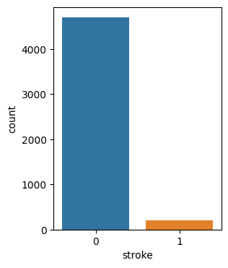
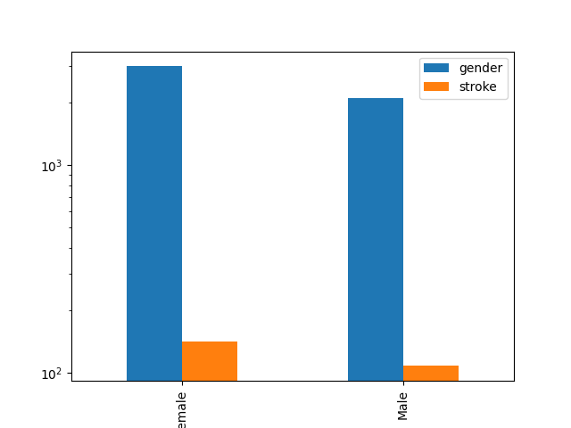
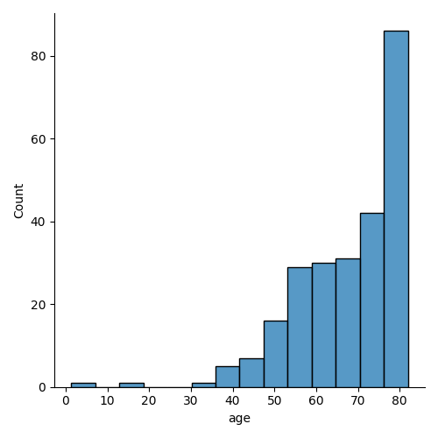
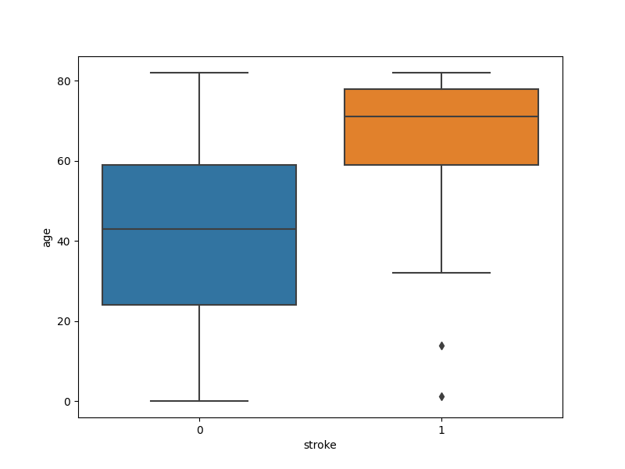
Imbalanced Data
Age and Stroke.
Distribution of age with respect to incidence of stroke.
Gender representation in data.
Class Imbalance.

Slide 5
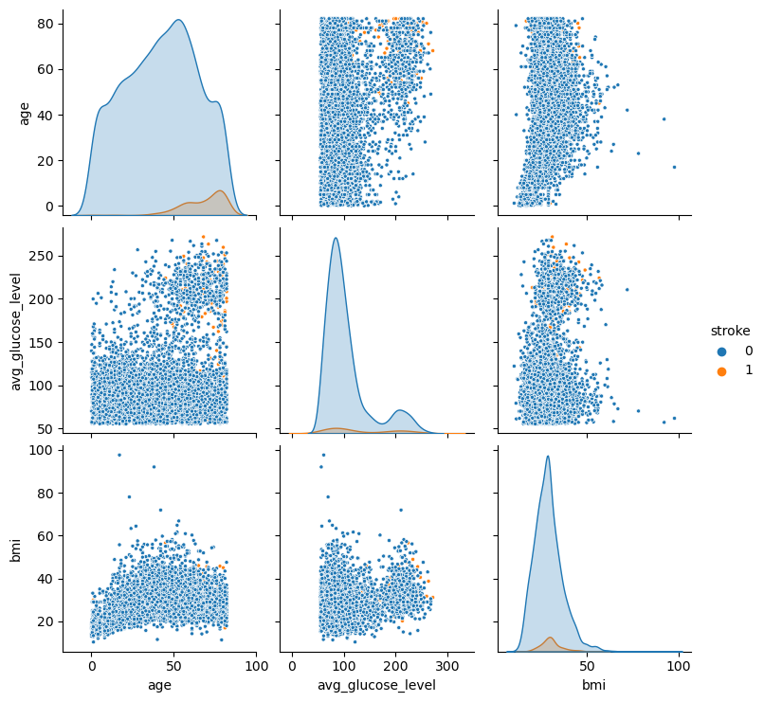
Data Distribution:
Data Distribution Overview:
Higher Correlation:
Age and stroke.
Glucose Level and stroke

Slide 6
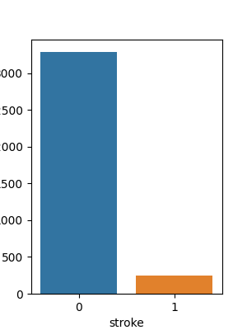
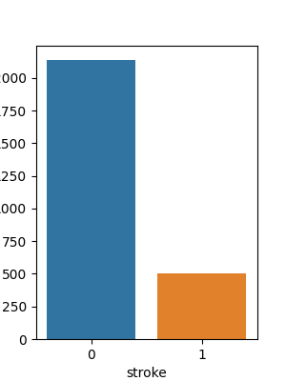
Data Processing:
Removing outliers:
It also helped in balancing the majority and minority classes, since we found the outliers of positive stroke cases with respect to age and remove the lower limit including the instances that fell in that range. Though not much, the relative ratio at this point is 93 : 7 up better from 95:5.
Encoding the categorical features using One-Hot Encoder.
Splitting the data set into training and testing set (70:30).
Resampling using SMOTE (Synthetic Minority Oversampling).
This oversampling policy was used for training set alone, training class ratio(75:25).

Slide 7
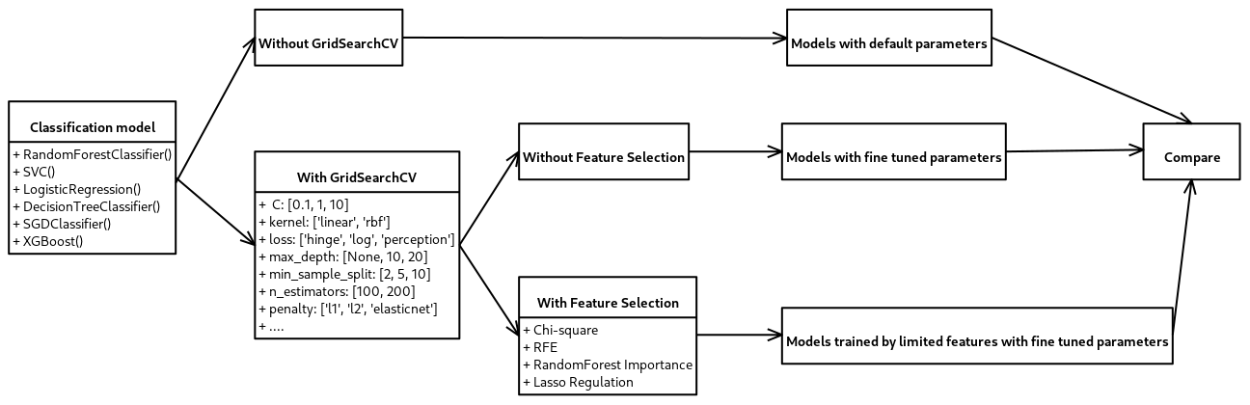
Model selection

Slide 8
Models and Strategies Performance Comparison:
Performance metrics utilized:
Accuracy.
Precision.
Recall.
Strategies used:
Default Parameters (No Grid Search)
Grid Search for hyperparameter space.
Feature Filtering process and training based on most important 7 features.
Models used:
Random Forest Classifier
SVM
Logistic Regression
Decision Tree
Stochastic Gradient Descent.
Features Selected:
Average Glucose Level
Age
Hypertension
Heart Disease
Residence Type
Work type: Self-Employed
Smoking Status: Smokes

Slide 9
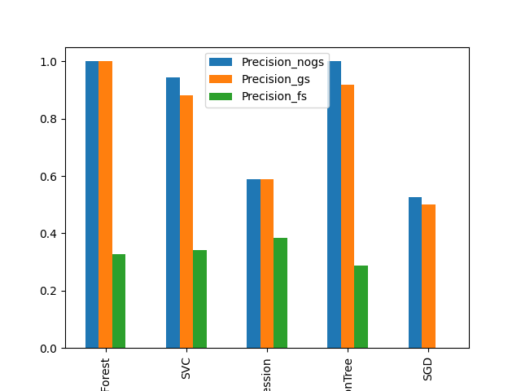
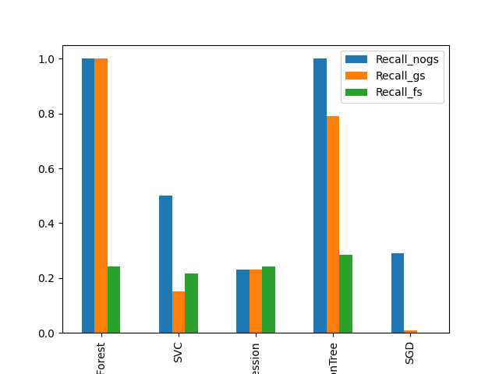
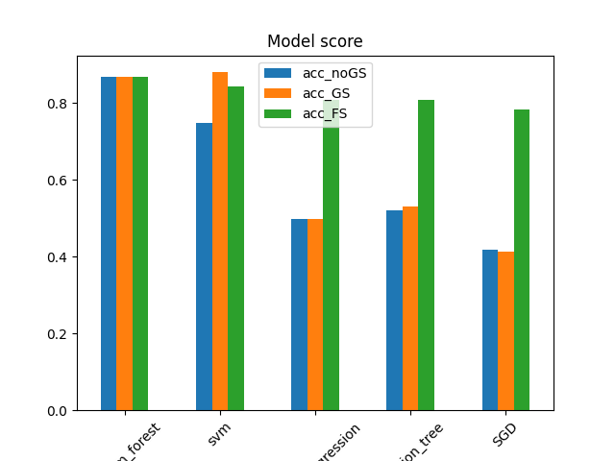

Slide 10
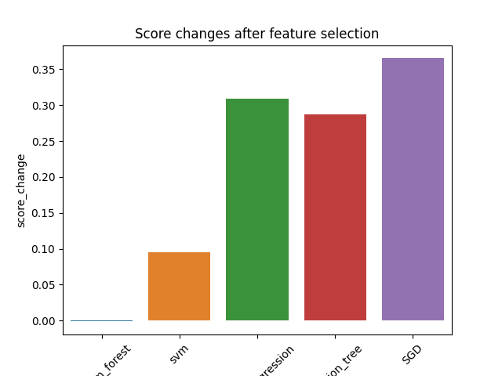
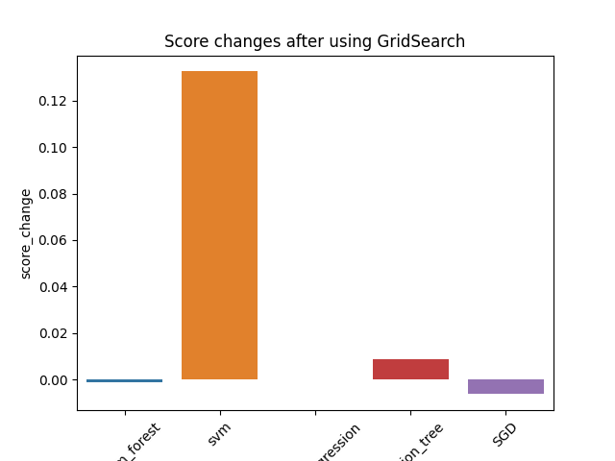

Slide 11
Where from here:
Model Evaluation & Selection
After thorough evaluation, we selected the best predictive model for our use case.
Weight Saving
We preserved the model's trained weights to ensure consistent performance.
We also saved the preprocessing scalers and encoders to maintain data consistency.
Streaming Data Integration
To serve a wider audience, we developed an interface for user input.
Users can input their details, and our saved model processes the data in real-time.
Risk Probability Prediction
Utilizing the preserved model, we provide users with an instant risk probability score.
This score is generated based on the predictive power of our model.
Seamless User Experience
Our goal is to offer a seamless experience, whether for batch processing or real-time predictions.
Users can now access our risk assessment service effortlessly.

Slide 12
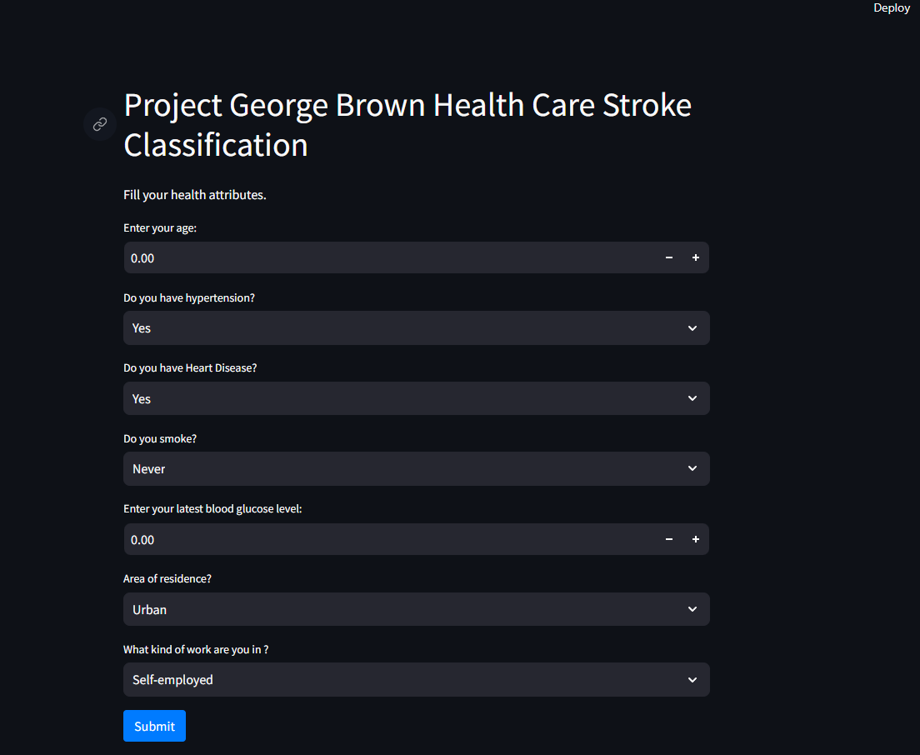

Slide 13
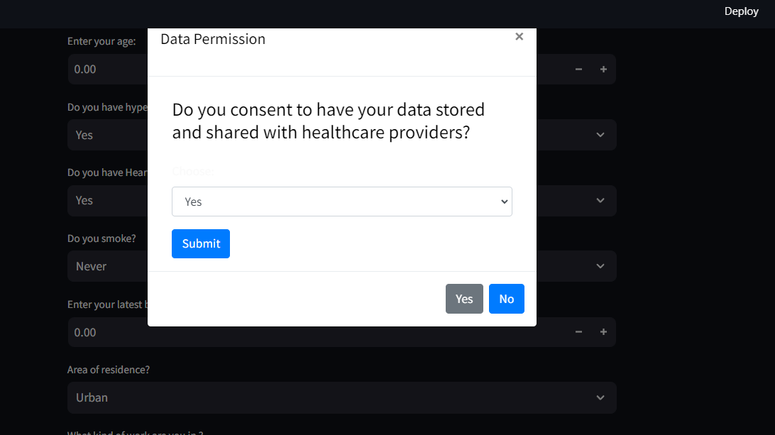

Slide 14
